Slide 1
100476935
Bsc Computer Science (with hons)

Slide 2
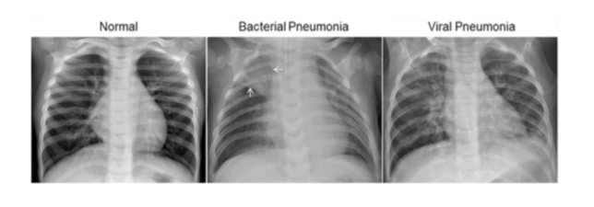
The Chosen Dataset
Chest x-ray images (pneumonia)
Why did I select this dataset?
Personal:
Personal interest in AI with a goal of clinical impact.
Professional growth relevant to my field (data engineer).
Ease of access / Interpretation:
More clearly defined scope compared to the language model option.
Data availability.
More tangible application.
More tangible impact on field (looking into capsule networks).
Computational Considerations:
Focus on computational efficiency.
Focus on optimization rather than outcomes.
Difficulty of training between projects.

Slide 3
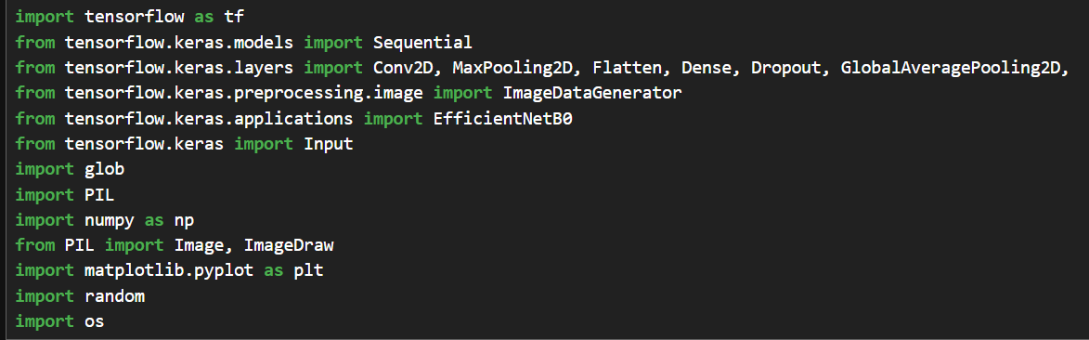

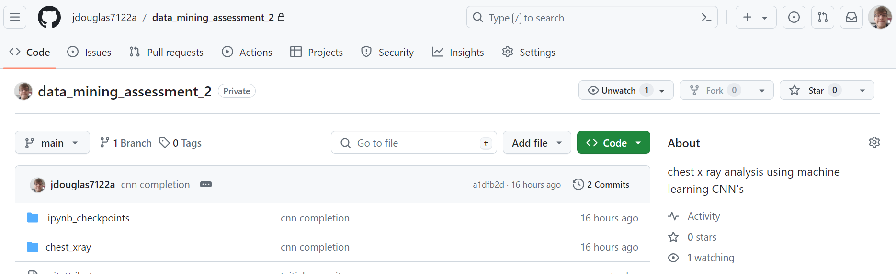
Project Prerequisites
Packages:
Download of the dataset from Kaggle:
Setup of Git Repository:
https://github.com/jdouglas7122a/data_mining_assessment_2

Slide 4
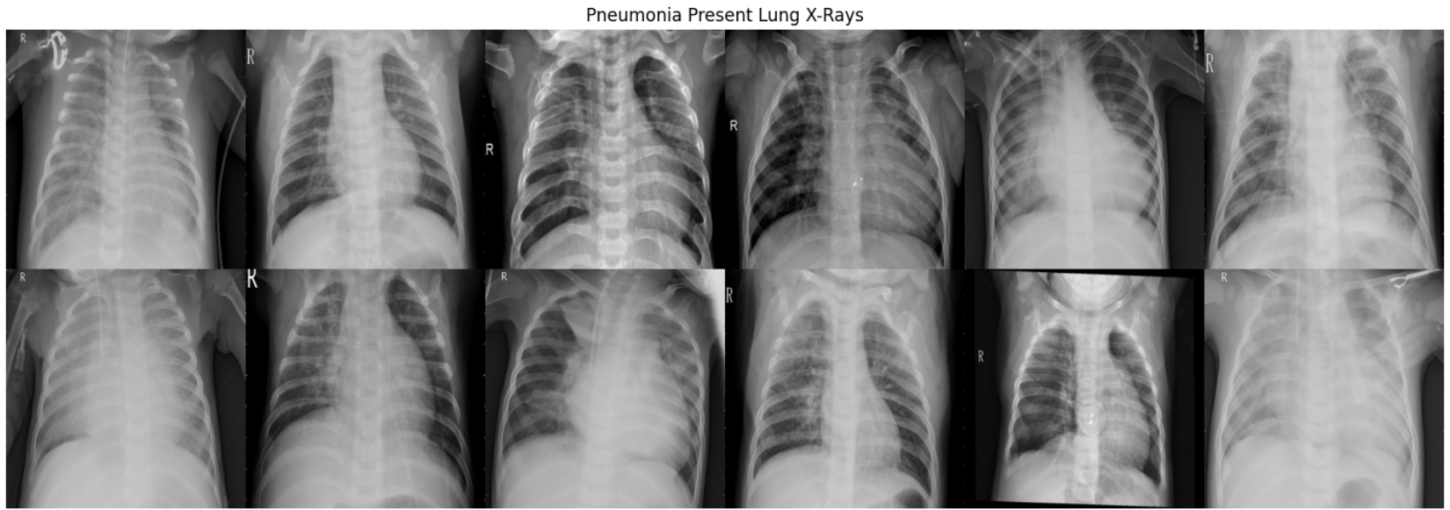
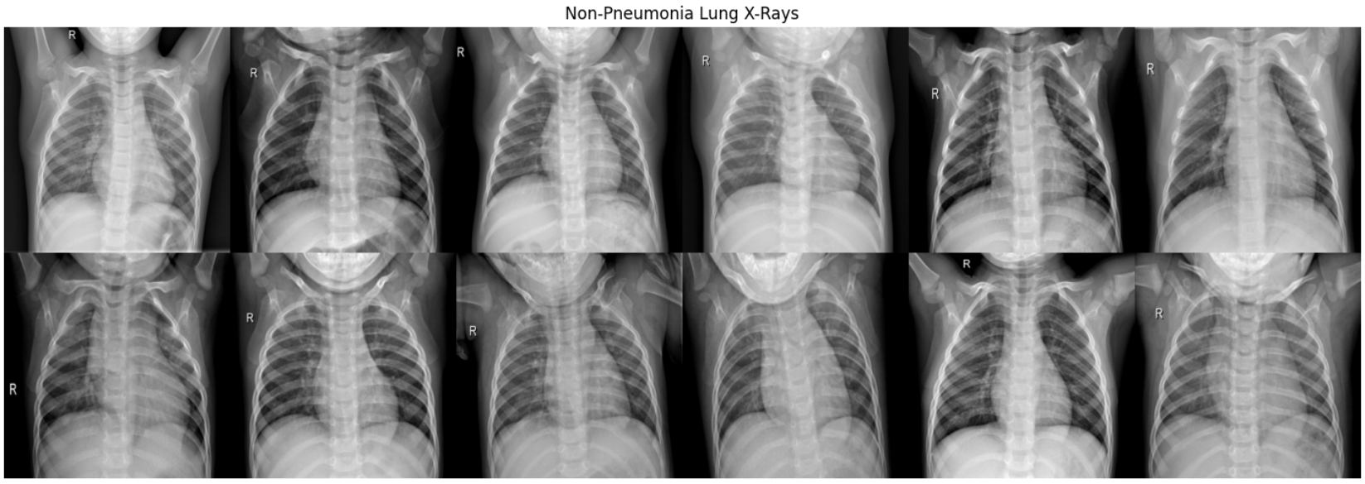
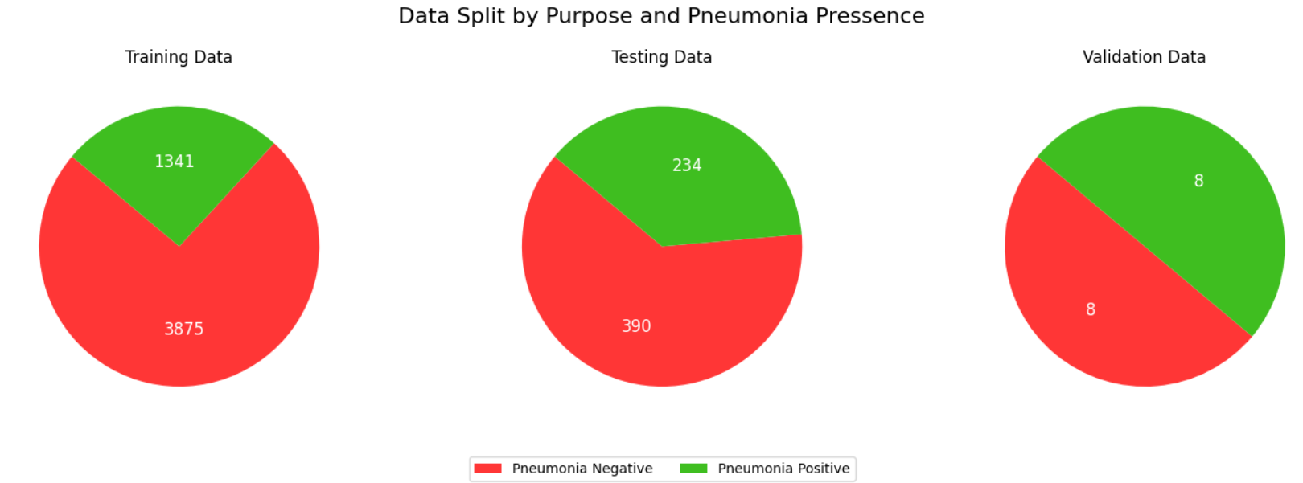
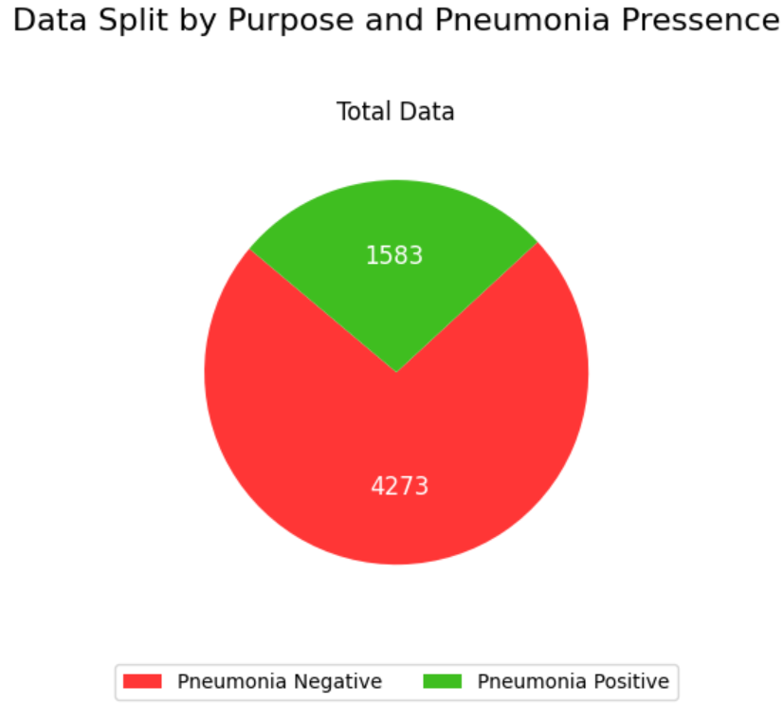
Exploratory Data Analysis
Features that might indicate pneumonia:
Consolidation (areas of white in the lung).
Cavitation (Cavities in the lung).
Air Bronchograms (alveoli filled with fluid making bronchi more visible and dark).
Pleural Effusion (Nonspecific to pneumonia, excess fluid in the pleural space, the thin fluid filled space between two pulmonary pleurae of each lung).
Preibronichal thickening.
Volume loss (collapse of lung tissue).
Interstitial patterns (more diffuse, reticular pattern).
Considerations for pre-processing:
Dataset as a whole:
Clear Skew towards non-pneumonia Cases.
Anomalies (quantity and severity).
Image Information:
Image transformation to prevent overfitting.
Pixel density.
Colour palette.
Image Dimensions.
Image Noise.
Metadata Analysis.

Slide 5
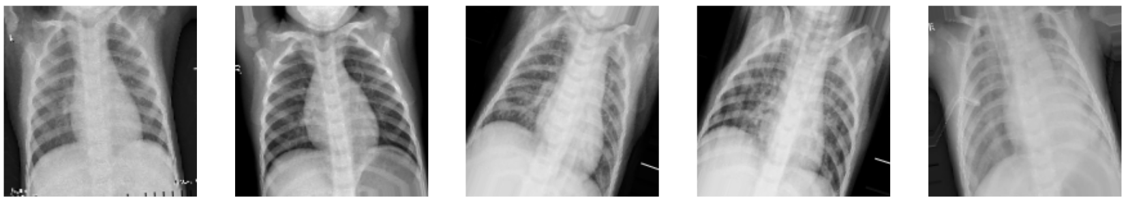
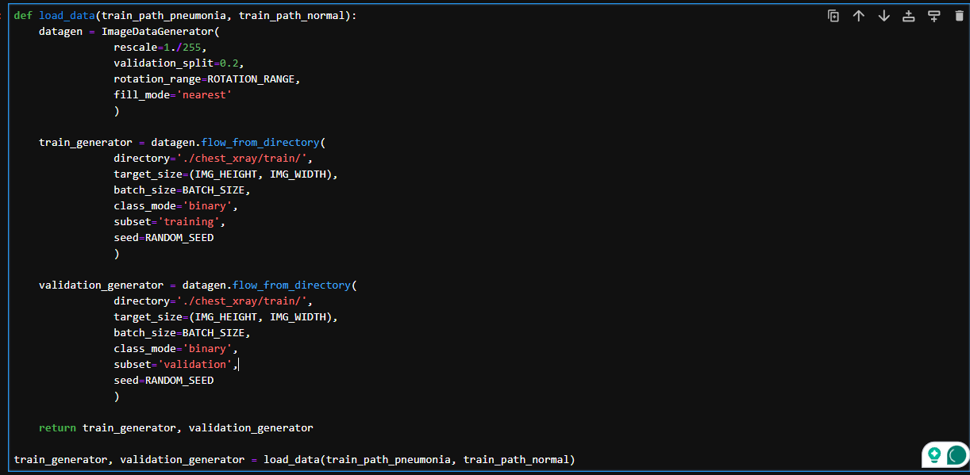
Pre-Processing
Normalization of image dimensions
Image Translations:
Colour palette verification (greyscale).
Image Generator:
This will apply the Translations and any further transformations to the dataset, drawing data from a given directory.
Also defines the type of class (binary) and the subset of the data (training or validation).

Slide 6
Model Selection
Computational Benefits and Cost:
Low computational cost.
High efficiency.
Low training time.
Robustness / generalization.
Scalability.
Correct model for the dataset:
Can identify subtle features in the chest x-rays.
Likelihood to experience overfitting.
Knowledge required:
Reduction in complexity where possible through packages such as tensorflow.keras.
Amount of work needed post training to get model results desired such as parameter tuning.
Ability to integrate with other models.
Maintenance & further training.
Support costs.

Slide 7
Capsule Networks
A capsule network is an experimental type of Artificial Neural Network (ANN).
Normal ANN’s struggle with understanding spatial hierarchy between objects().
To fix this problem, capsule networks use groups of neurons called capsules which are especially good at maintaining spatial relationships between different features of a relationship().
Within this ANN, there are multiple layers of capsules.
Uses dynamic routing of traffic.
Although exciting, these types of neural network are still very experimental and have little support among libraries such as keras, requiring a more complex understanding in order to use and fine tune.
Capsule networks are more computationally intensive than traditional neural networks, and have large scalability issues.
Notes:
!) in leymans terms, a capsule network is a team of experts where each member is responsible for understanding a specific part of a problem and knows how to efficiently communicate with other experts to build a comprehensive understanding of the entire issue.
2) For example, it doesn’t just understand the presence of an eye in an image, but its orientation, size and position relative to other features
3) Lower layer capsules detect simple features (like edges of objects) while higher level capsules combine these features to recognise more complex objects.
This allows for more complex structures to be understood in a more robust way, especially when taking into account orientation.
4) Dynamic routing decides how information should flow from lower to higher level capsules, this helps the network focus on the important spactial relationships in the image, even in unusual contexts.
5) Capsule networks are best suited for problems where the features needing detection can vary in size and location, as this is where the capsule networks power is most emphasized.

Slide 8
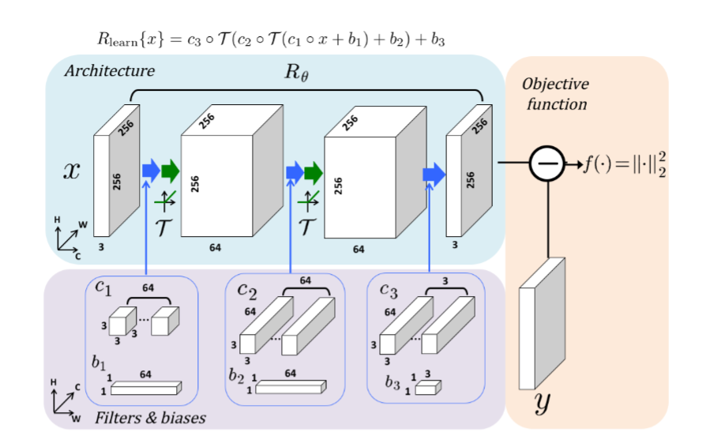

Convolutional Neural Networks
A type of deep learning algorithm that’s good at processing information with a grid like topology.
Images are converted into grids which then allows the algorithm to convolve over, generating feature maps which indicate a true or false value in binary classification.
Pooling takes individual samples and summarises them based on a frame value.
Activation functions take the pooled data outputted from the previous layers, and determines which data is passed to the proceeding layer.
Dense layers calculate a weighted sum of its inputs to help with decisions or predictions
Dropout Layers regularize the data by periodically 0’ing output from neurons to prevent co learning, encouraging learning different paths through neuron activation.
S. Premanand (2021) Convolution Neural Network – CNN Illustrated with 1-D ECG Signal, AnalyticsVidhya https://www.analyticsvidhya.com/blog/2021/07/convolution-neural-network-the-base-for-many-deep-learning-algorithms-cnn-illustrated-by-1-d-ecg-signal-physionet/
M.T. McCann Et al,. (2017) Convolutional Neural Networks Inverse Problems in Imaging: a Review, IEEE Signal Processing Magazine, 34, 85-95
Notes:
Good for grid like topology
Sequential, so neurons are grouped by layer and purpose,
-although dynamic routing can be implemented in sub-groups of neuron
3) Generally images are padded

Slide 9
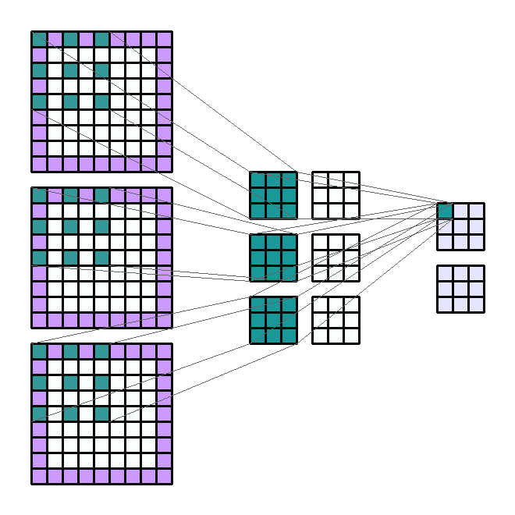

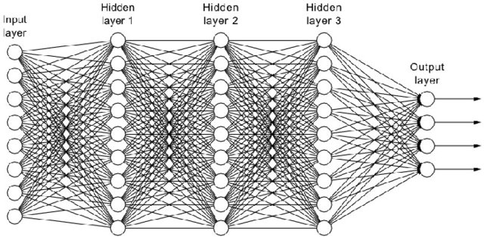
CNN Layers Explained: Conv2D, maxpooling2D, Dense
A. Thevenot (2020) Conv2D: Finally Understand What Happens in the Forward Pass, Medium https://towardsdatascience.com/conv2d-to-finally-understand-what-happens-in-the-forward-pass-1bbaafb0b148
NumPtNet, Max Pooling Layer
https://nico-curti.github.io/NumPyNet/NumPyNet/layers/maxpool_layer.html
Y.D. Wang et al,. (2021) Deep Learning in Pore Scale Imaging and Modeling, Earth-Science Reviews, 215
Notes:
Stencil sliding over the image by a slide value
Stencil slides and gradually learns specific details
Edges
Textures
Colours
3) Think of the filter as this stencil
4) Sliding is convolving
5) Multiple filter values with the values of the original image
6) The result is passed to the next layer
Think of max pooling as a sieve which runs over the feature map, only letting through the largest chunks
A dense layer connects the input of every previous layer to the proceeding layer
Each neuron, weighted sum of inputs + bias -> activation function
3) This reduces linearity of the output.

Slide 10
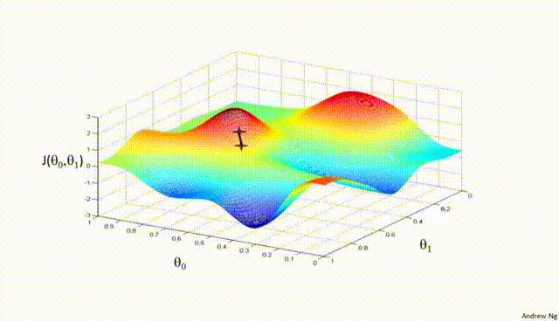
Aside: The vanishing gradient problem
Y.D. Wang et al,. (2021) Deep Learning in Pore Scale Imaging and Modeling, Earth-Science Reviews, 215
Y. Bohra (2024) The challenge of vanishing / exploding gradients in deep neural networks, AnalyticsVidhya, https://www.analyticsvidhya.com/blog/2021/06/the-challenge-of-vanishing-exploding-gradients-in-deep-neural-networks/
Notes:
With multiple layers, as we pass through the model, gradually the gradients of the model will reduce bit by bit, results in a vanishing effect, this can lead to ineffective training of the network
Activation functions assist in resolving this.

Slide 11
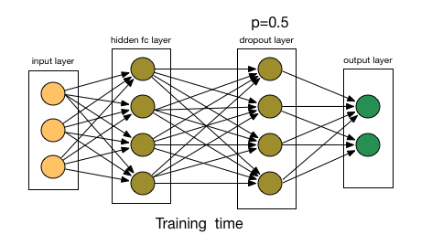
CNN Layers Explained: Dropout
Notes:
Periodically shuts of nerons to promote new paths in the network
Prevents co-learning

Slide 12
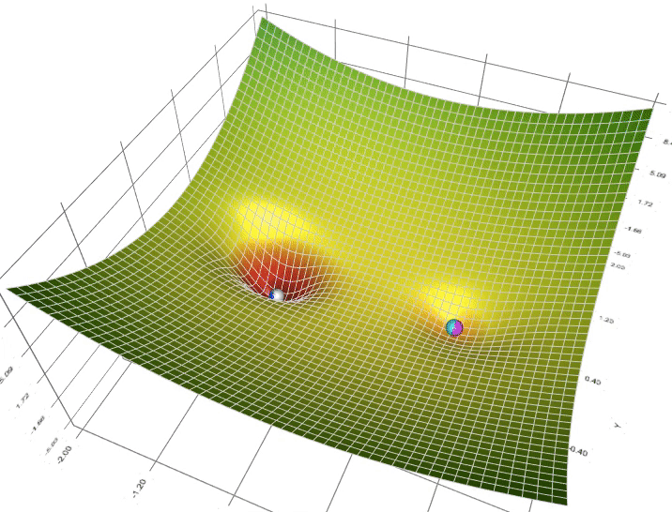
CNN methods: Adam Optimizer
Notes:
The adam optimizer adjusts the learning rate the the model is trained
Adam keeps track of an exponentially decaying average of the gradients of the model, keeping track of past gradient and adjusting accordingly.
This almost acts as momentum of the model, and by adjusting the learning rate, we can compensate for the slowing of momentum (vanishing gradient problem)
-adam was chosen for this model due to the different layers having different learning rates, an area where the dynamic learning rates thrive
-additionally its incredibly scalable, working better in deeper neural networks.
Alternatives include:
Stochastic gradient descent:
Updates parameters in the direction that reduces error the most
One of the simplest of the optimizer class
Doesn’t thrive in a dynamic learning speed environment
Root mean square optimization:
Adjusts parameters that have the most frequent usage lower learning rates while giving low activation nodes higher learning rates
Very good in early training, but quickly falls off as training continues.

Slide 13
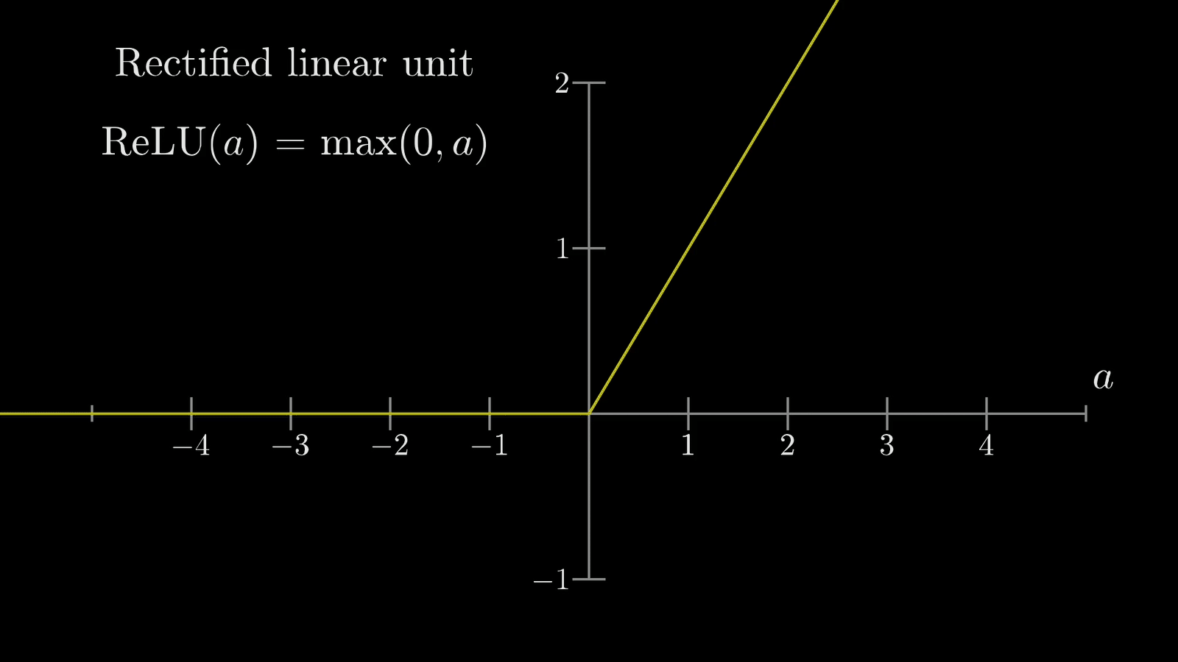
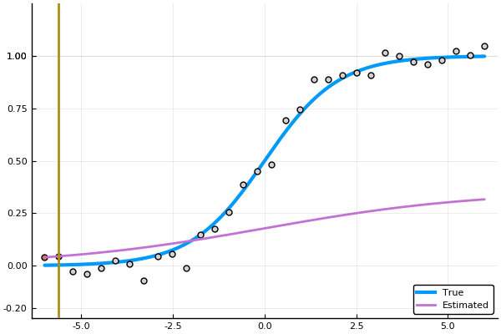
CNN methods: Activation Functions
Relu:
Sigmoid:
Notes:
Relu only activates when the value given is above 0, otherwise it returns 0
Sigmoid is normally used as an output layer
Keeps the output between 0 and 1, used to predict probability of an outcome.

Slide 14
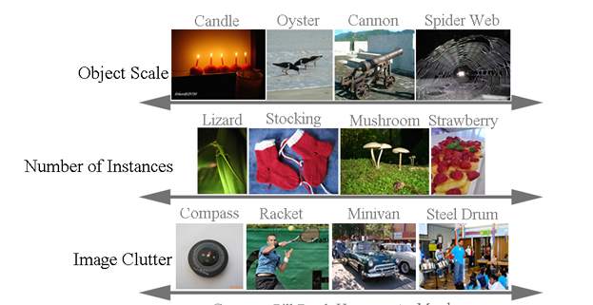
Transfer Learning with Pre-Trained Models
Uses models pre-trained on other images to try to take advantage of the patterns its previously detected applied to your problem
Reduces training time for a much more complex network.
Some Examples:
ResNet
EfficientNet
InceptionV3
Xception
VGG16 & 16
EfficientNet is trained on a database called ImageNet which consists of over 20000 categories, its specified for research of image classification.
O. Russakovsky et al,. (2015) ImageNet Large Scale Visual Recognition Challenge, arXiv:1409.0575v3

Slide 15
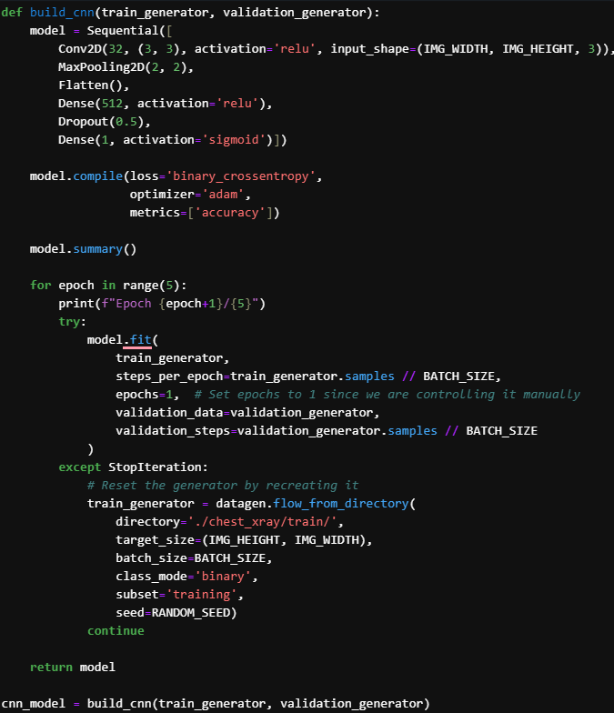
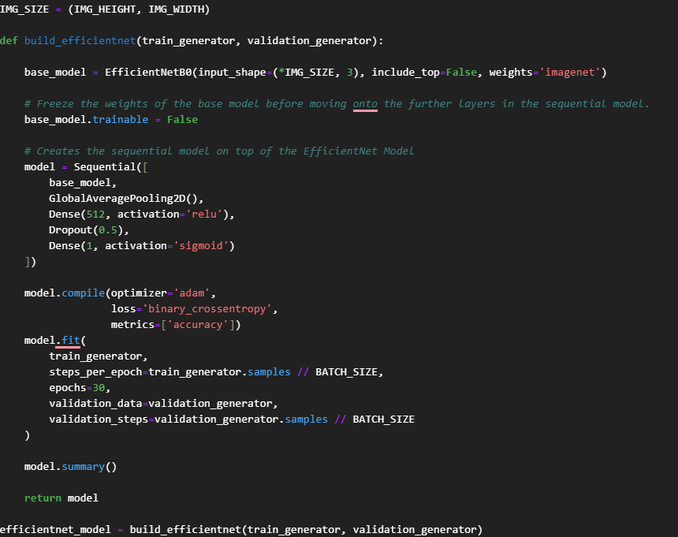
Initial Models Built

Slide 16
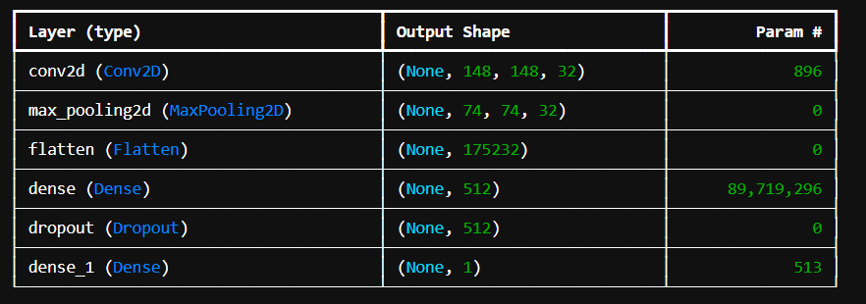
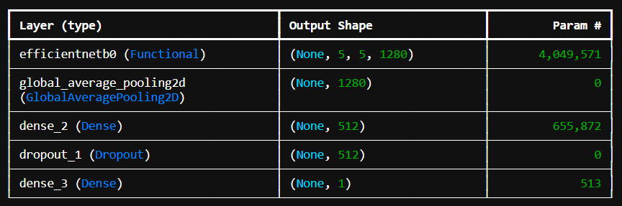
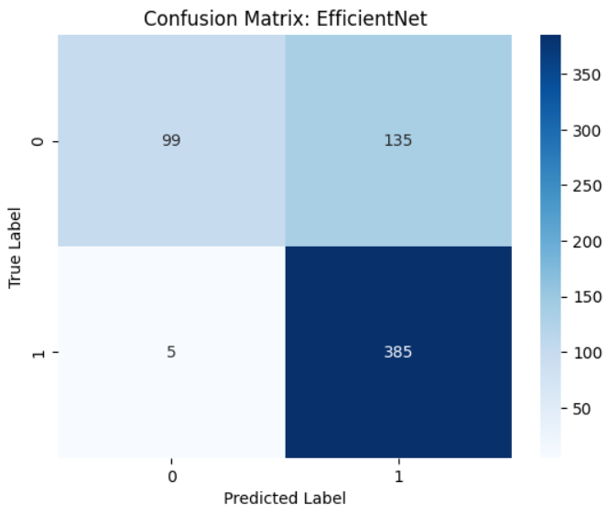
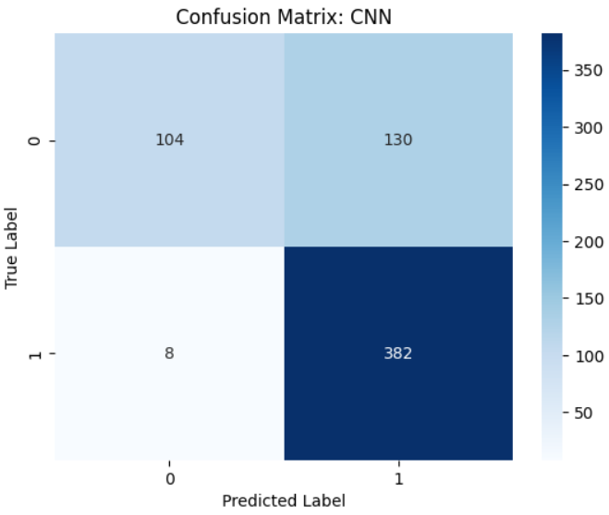
Initial Model Results
Abysmal training time
Awful accuracy of 28% with a loss of 1.01
With this low of an accuracy rate it is clear the amount of tuning needed will not be worth the result, so we’re going to focus on the CNN from here
Sub standard results, achieving 90% training accuracy but after testing, only achieved 53%
Huge loss rate of 1.2

Slide 17
Possible Model Improvements:
Data Augmentation:
Possibly using more synthetic information with even greater random transformations could make the model adapt.
Increase data volume:
Currently we are pulling all data from the training and validation set, when we have a testing set available, this may increase the model accuracy.
Learning rate:
Tweaking the rate at which the model learns may improve model stability
Add new layers:
Additional dropout layers or increasing the dropout rate may be beneficial for accuracy
Hyperparameter tuning:
including different learning rates and changing optimizer might increase accuracy
Callbacks:
Early stopping and learning rate schedulers to dynamically adjust the training process may help with the instability
Improvements to data set, currently the validation set is tiny compared to the testing and training sets, this may cause strange behaviour such as overfitting, or poorly optimized weights.

Slide 18

Improved Model Results:
Huge improvements while increasing training time
74% accuracy with a 0.7 loss
The main problem now is false positives
False negatives nearly never happen
The model is best at predicting positive pneumonia but has clear bias towards labelling something as pneumonia, as we see only 107 predictions are ‘normal’ and 517 being predicted as ‘pneumonia’, it's clear we need to do more data augmentation and adjust learning rates to further reduce this .

Slide 19
Conclusions & Further Research:
Access to these computationally complex models with less knowledge is becoming more and more common, so we need to continue moving towards standardizing ML Packages.
While the results of Efficient Net were lacking due to this projects simplicity approach, the CNN shows promise, with very small changes (such as the change to the val set) having staggering impact
In research, using a CNN, multiple people on this problem have achieved above 85% accuracy with low training times, showing how powerful a simple CNN can be.
Multiple other solutions and adjustments have been attempted, such as checkpoint implementation on efficient net with large increase in accuracy, but still below 60%.
The same changes were applied to the CNN, reducing its accuracy.
Pytorch is a package owned by Facebook we did not touch on in this project, although its not beginner friendly and requires more knowledge of CNN’s / ML to use, it has huge potential.
I believe the packages will continue to abstract the complex elements of ML away from the user, decreasing the ability to tweak and tune but exponentially increasing the general publics ability to engage with the technology.

